Slide 1

Does protected area connectivity moderate the efficacy of protection on tropical biodiversity
Evidence from a replication of Brodie et al. (2023)
Peter Kedron, Amy Frazier, Lei Song, Wenxin Yang
peterkedron@ucsb.edu
2024 Annual Meeting of the American Association of Geographers | Honolulu, HI

Slide 2
30x30
Target 3 of the Kunming-Montreal Global Biodiversity Framework
Ensure and enable that by 2030 at least 30% of terrestrial and inland water areas, and of coastal and marine areas, especially areas of particular importance for biodiversity and ecosystem functions and services, are effectively conserved and managed through ecologically representative, well-connected and equitably governed systems of protected areas and other effective area-based conservation measures, …
Kedron et al.
Does PA Connectivity Moderate the Efficacy of Protection?
Original Analysis

Slide 3
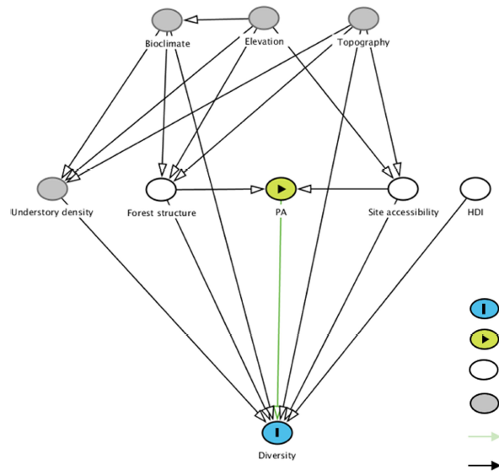
Brodie et al. (2023)
Analysis and key claims of the original study
Brodie et al. demonstrated the efficacy of terrestrial protected areas (PA) for conserving bird biodiversity while accounting for the confounding effects of 3D forest structure and accessibility.
Predictors
PA Sample site inside/outside Protected Area
Forest Canopy height (habitat quality)
Access Circuit theory derived measure (hunting pressure)
HDI Human development index
Response
Diversity Functional Richness, Species Richness, Phylogenetic Diversity
ED Fig. 2 | Directed acyclic graph of bird and mammal diversity in relation to exposure variables and covariates
Kedron et al.
Does PA Connectivity Moderate the Efficacy of Protection?
Original Analysis
Notes:
Linear mixed-effects model with national-level random effects and exponential correlation structure based on covariance in pairwise distances among sites.
Propensity score matching to deconfound effects of PA selection.

Slide 4
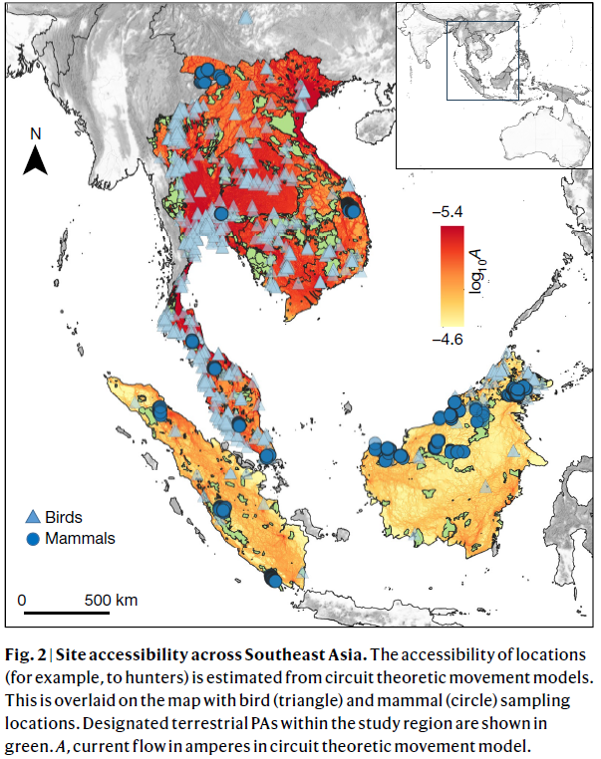
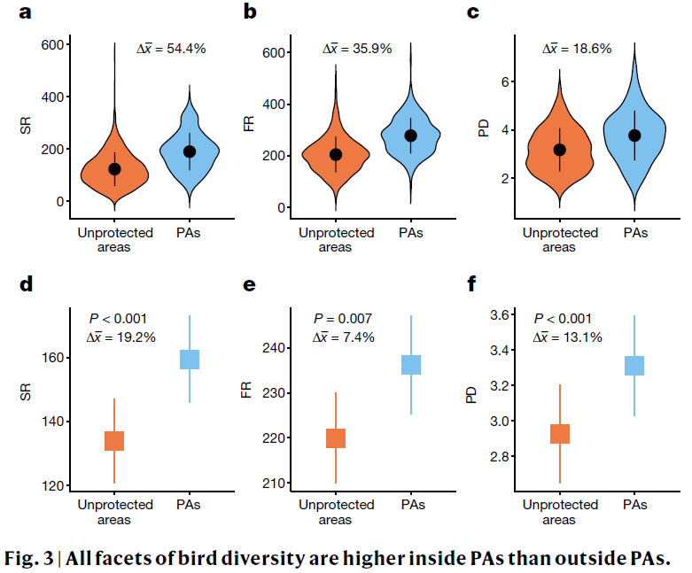
Brodie et al. (2023)
Analysis and key claims of the original study
(a-c) violin plots of biodiversity, (d-f) Spatial mixed effects regression on propensity score
matched data
Kedron et al.
Does PA Connectivity Moderate the Efficacy of Protection?
Original Analysis

Slide 5
30x30
Target 3 of the Kunming-Montreal Global Biodiversity Framework
Ensure and enable that by 2030 at least 30% of terrestrial and inland water areas, and of coastal and marine areas, especially areas of particular importance for biodiversity and ecosystem functions and services, are effectively conserved and managed through ecologically representative, well-connected and equitably governed systems of protected areas and other effective area-based conservation measures, …
Kedron et al.
Does PA Connectivity Moderate the Efficacy of Protection?
Original Analysis

Slide 6
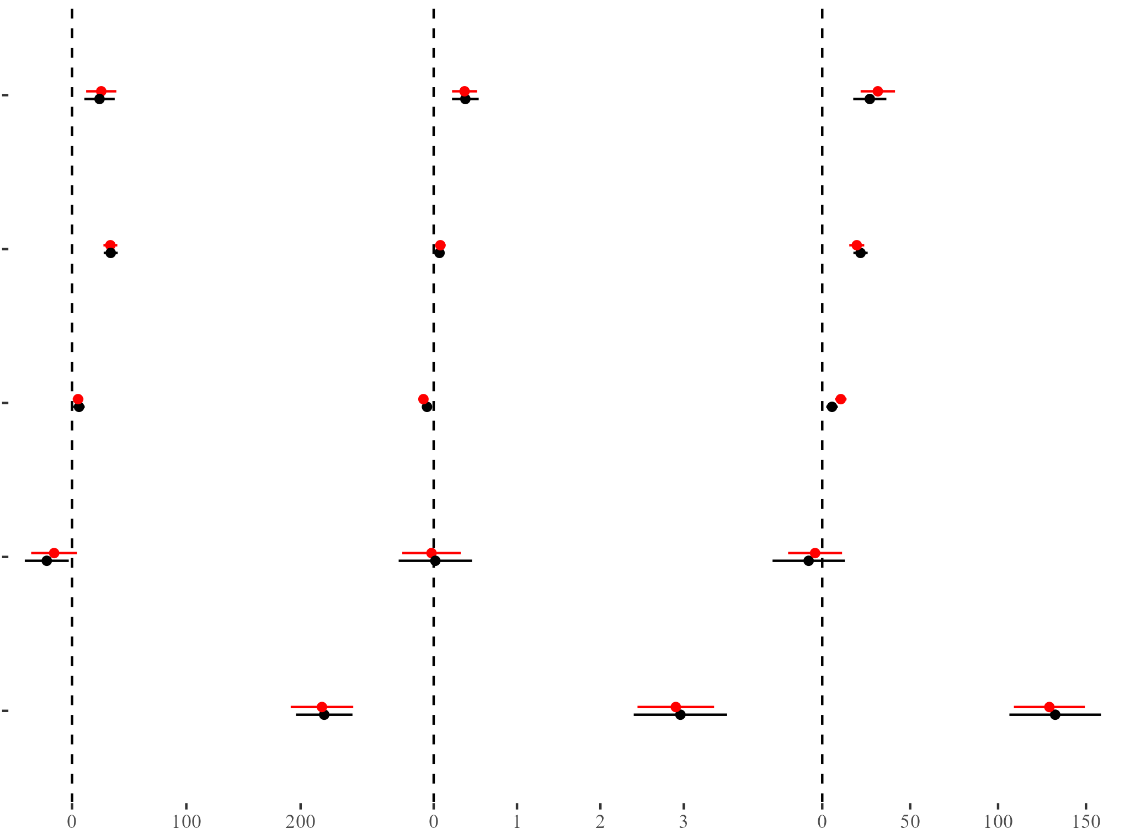
Computational Reproduction
Matching effect estimates observed across studies
Functional Richness
Phylogenetic Diversity
Species Richness
Positive effect of protected
Area conservation on
tropical bird biodiversity
Protected Area
Forest Canopy Height
Site Accessibility
HDI
Intercept
Reproduction
Brodie et al.
Estimate of effect

Slide 7
Reproducibility Check
We identified a series of minor issues and areas of concern in the original analysis
Minor Concern
Omission
Construction
Spatial
Brodie et al. did not include HDI measures in the public data file
Procedures to construct GEDI predictors were not provided in public code
Information about projections and distance calculations was omitted
Accounted for, but did not test for remaining spatial structure in model residuals
Moderate Concern
Standardization
Leverage
Brodie et al. centered variables on complete dataset, but regressed on subset
Removed outliers based on complete dataset, but regressed on subset
Kedron et al.
Does PA Connectivity Moderate the Efficacy of Protection?
Computational Reproduction

Slide 8
Replication Design
Introduce connectivity as a predictor of biodiversity and moderator of PA efficacy
lme(Diversity ~ Brodie + conn + conn:PA,
random = list(~1 | country),
data = dat_matched,
weights = ~I(1/weights),
correlation = corExp(form = ~utm_east + utm_north,
nugget = TRUE)
)
Connectivity
ED Fig. 2 | Modified DAG of bird diversity in southeast Asia
Kedron et al.
Does PA Connectivity Moderate the Efficacy of Protection?
Replication Attempt
Notes:
Theta is the median dispersal distance for a species, which give a 50% probability of dispersal at that distance
We tried four version of this calculation 2 vector, 2 raster. They produced highly correlated measures that did not alter the regression estimates

Slide 9
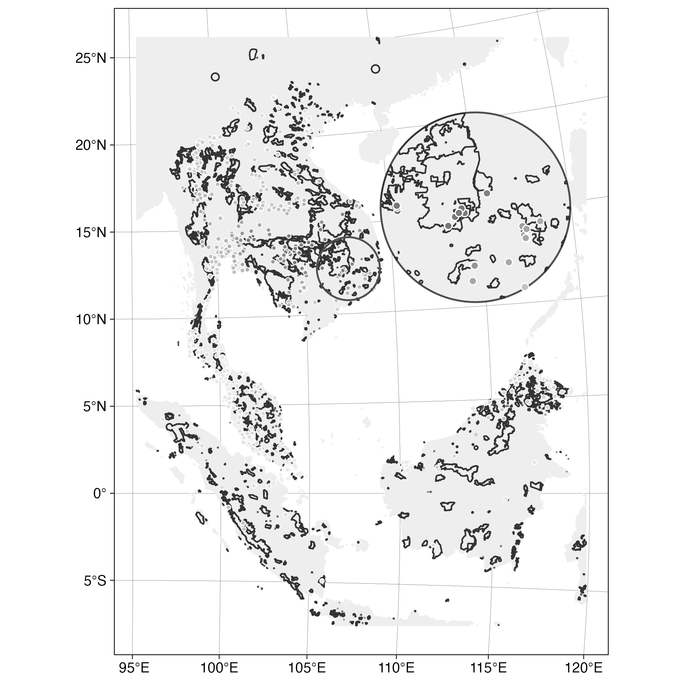
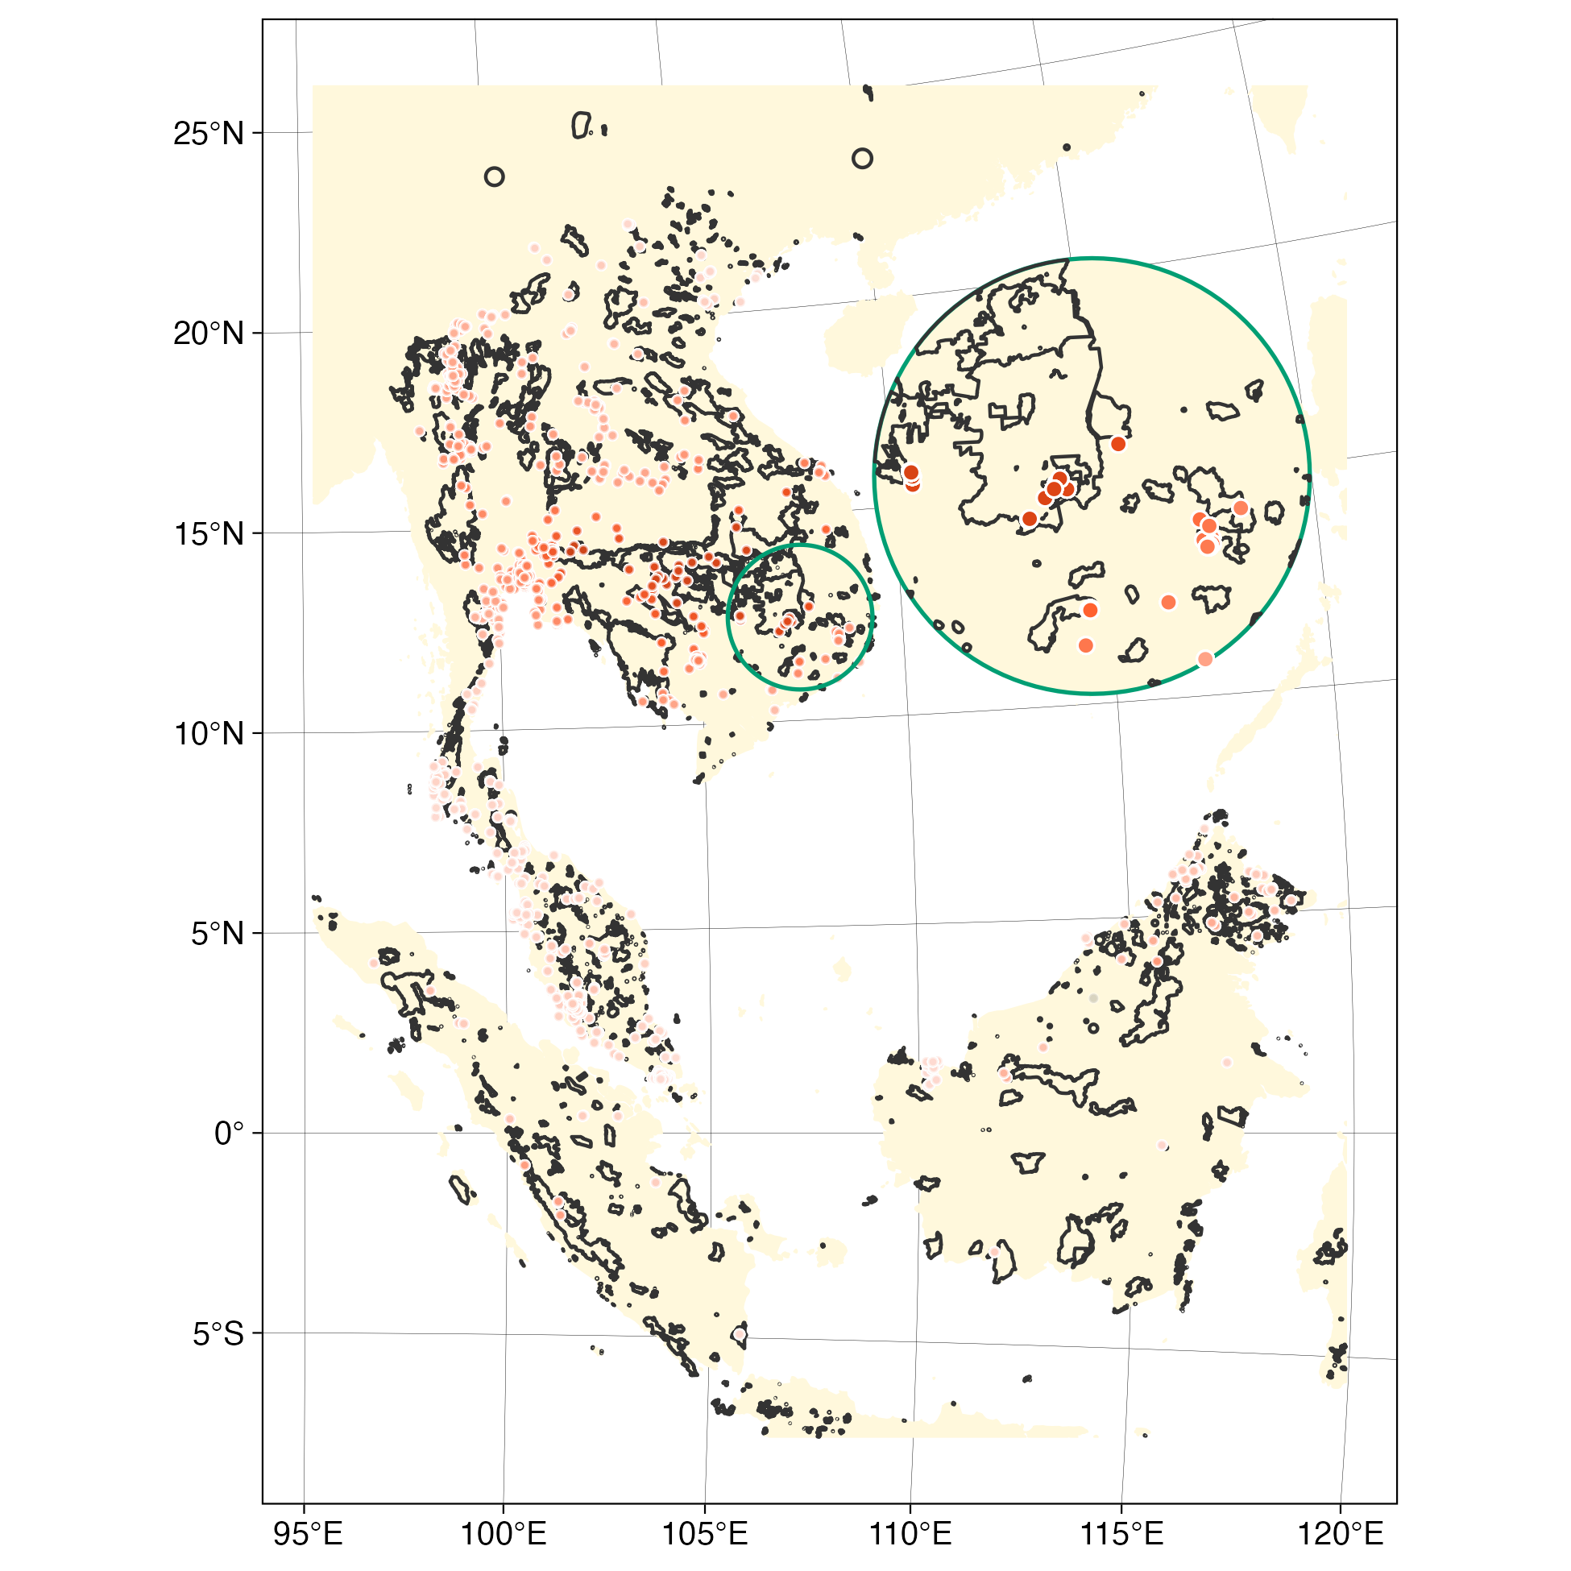

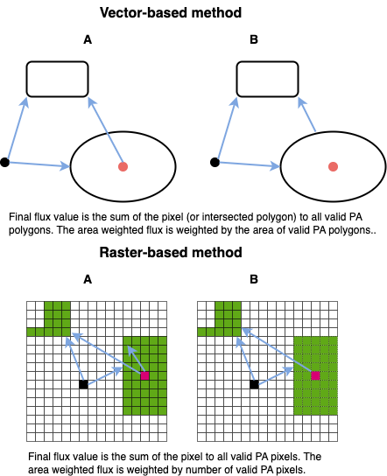
Replication Design
Introduce connectivity as a predictor of biodiversity and moderator of PA efficacy
Kedron et al.
Does PA Connectivity Moderate the Efficacy of Protection?
Replication Attempt
Notes:
Theta is the median dispersal distance for a species, which give a 50% probability of dispersal at that distance
We tried four version of this calculation 2 vector, 2 raster. They produced highly correlated measures that did not alter the regression estimates

Slide 10
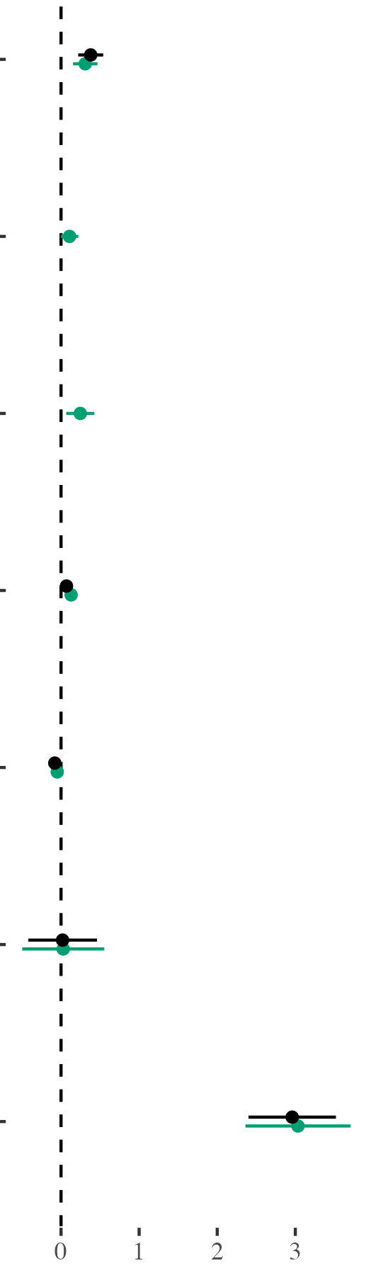
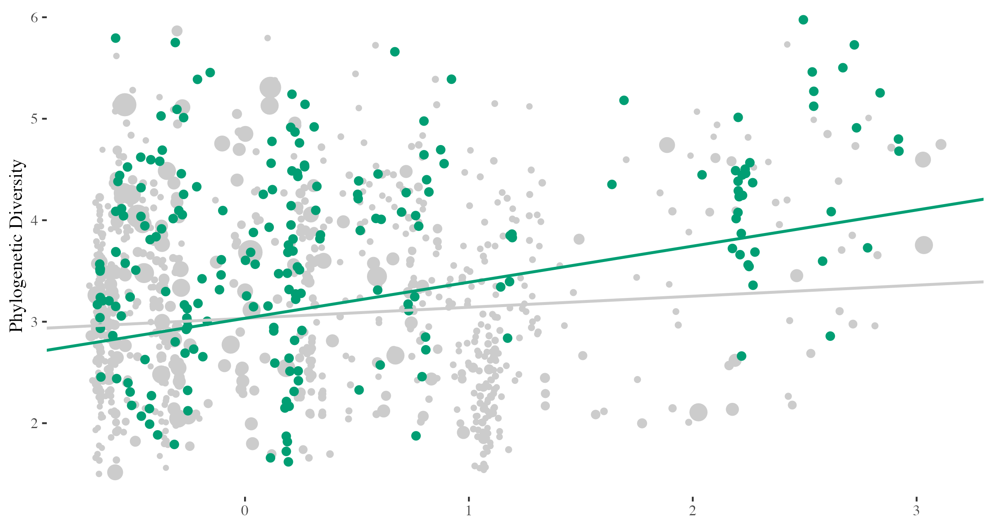

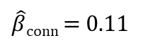
Connectivity Moderates PA Efficacy
On phylogenetic diversity, at a dispersal distance of 100km
Protected Area
$\hat{β}$_{conn} + $\hat{β}$_{conn | PA} = 0.36
Connectivity
PA | Connectivity
Forest Canopy Height
Site Accessibility
HDI
$\hat{β}$_{conn} = 0.11
Intercept
Estimate of effect
Protected
Connectivity
Unprotected
Notes:
Lei, remind me of the scale of awf_ptg.z

Slide 11
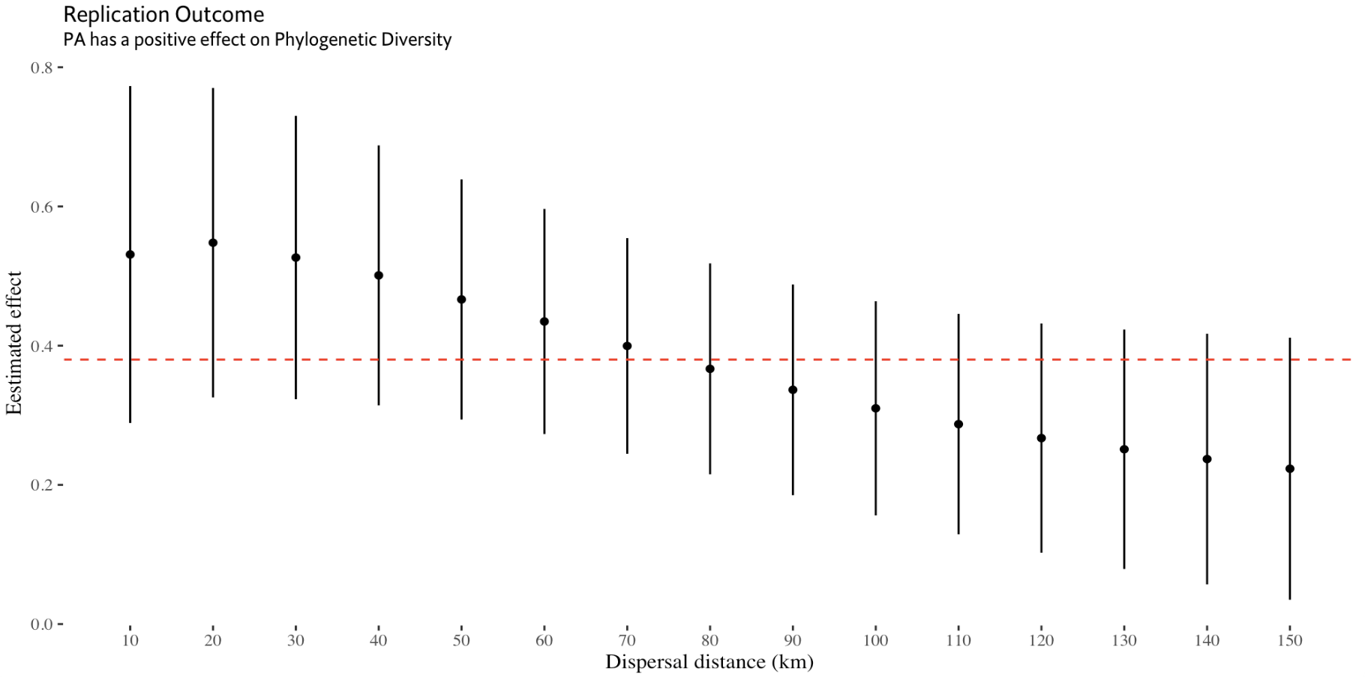
Robustness Check of PA Efficacy
PA efficacy has some sensitivity to dispersal distance selection, but statistically indistinguishable
Brodie et al.
Kedron et al.
Does PA Connectivity Moderate the Efficacy of Protection?
Replication Outcomes

Slide 12
Further Modifications
Conducting additional analyses before pre-print publication and submission
Primary Findings
Extension
Reproduction
Identified potential direct and moderating effects of connectivity, while preserving protective effect of PA conservation
Computationally reproduced effect estimates and supported conclusion and internal validity of Brodie et al.
Ongoing Work
Corrections
Spatial
Consistency
Check adjustments & extensions of original procedure (e.g., outliers, DAG)
Consider ways to address remaining spatial structure
Consistent positive direct and moderating effects of connectivity were only observed for phylogenetic diversity of birds
Kedron et al.
Does PA Connectivity Moderate the Efficacy of Protection?
Next Steps

Slide 13

Questions and Comments
The many paths we didn’t explore, the researcher degrees of freedom we used
Please contact me at peterkedron@ucsb.edu for the data and code used in this analysis. Our GitHub repository is currently under development and quite messy. However, we should have a clean repository (with messy development history tracked through version control) available soon along with a preprint summarizing our findings.
NSF Awards – BCS 2049837, BCS-2401273, DEB-2225079
2024 Annual Meeting of the American Association of Geographers | Honolulu, HI

Slide 14
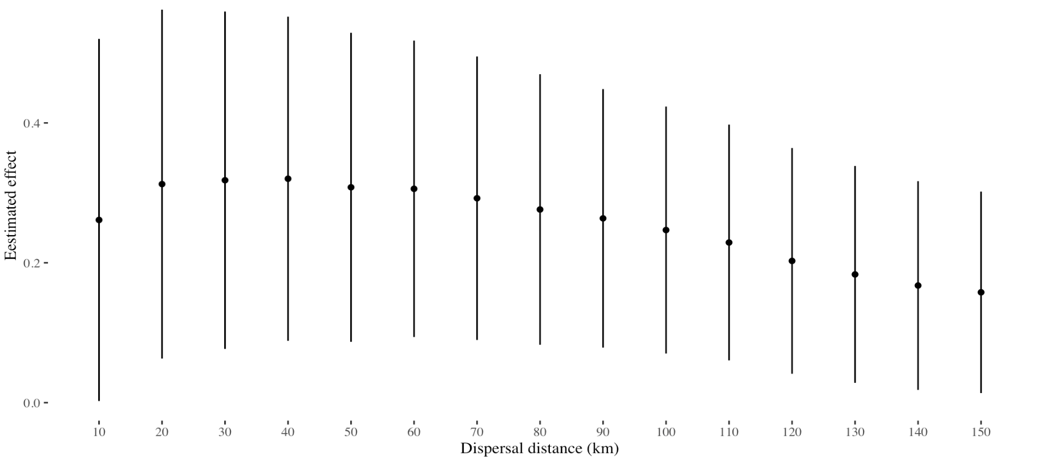
Robustness Check of PA Efficacy
The effect of connectivity is consistently positive across dispersal distances for Bird Phylogenetic Diversity
No Effect
Kedron et al.
Does PA Connectivity Moderate the Efficacy of Protection?
Replication Outcomes

Slide 15
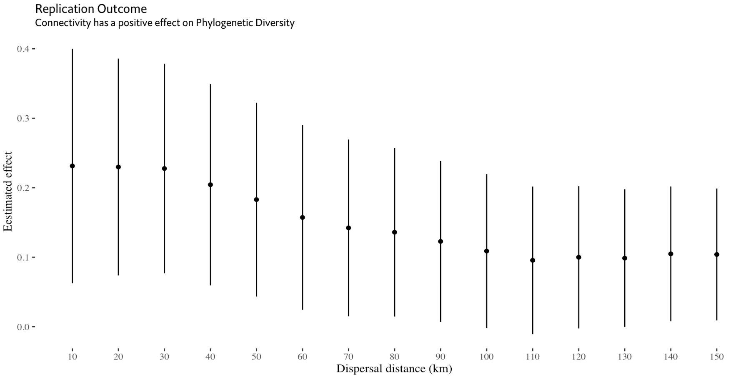
Robustness Check of Moderating Effect
The moderating effect of connectivity on PA is generally consistent across dispersal distances for Bird Phylogenetic Diversity
No Effect
Kedron et al.
Does PA Connectivity Moderate the Efficacy of Protection?
Replication Outcomes

Slide 16
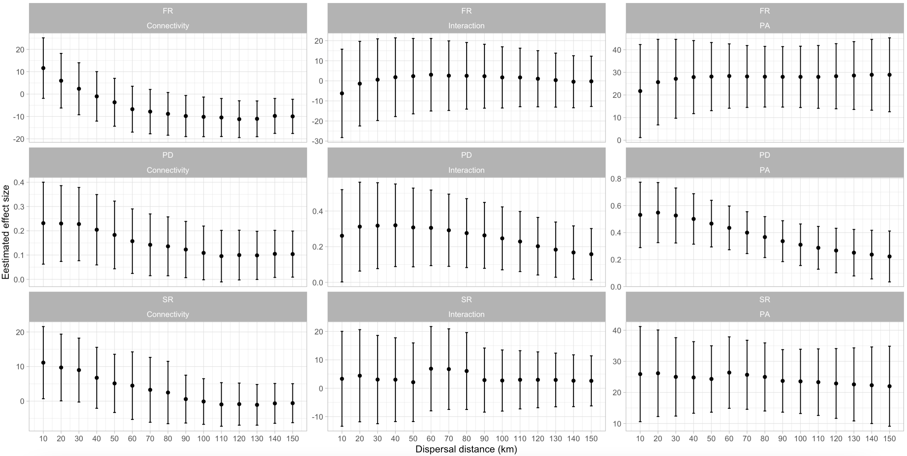
Further Robustness Checks
Inconsistency in effect estimates observed across dispersal distances for functional and species richness measures
Estimated Effects
Kedron et al.
Does PA Connectivity Moderate the Efficacy of Protection?
Next Steps

Slide 17
